Slide 1


Biosignal Analytics
Group 4 - Sleep stage classification using electroencephalography
Andrei Ivanov
Faiza Anan Noor

Slide 2
Presentation contents
The problem - Sleep stage classification
EEG Basics
Time-domain features
Frequency-domain features
Project workflow
Provided data: import and query
Functions for feature extraction
Dataset building
ML algorithms
Random Forest Classification
Support Vector Classification
Results, findings and conclusions
What could have been done differently?
Resources and references

Slide 3
The problem
Sleep stage detection
This project's goal is to classify sleep stages into six classes using machine learning algorithms: awake, REM, N1, N2, N3, and N4 by using features extracted from EEG signals.
Understanding Sleep Categories
REM Sleep vs. NREM Sleep:
REM: Rapid eye movements, irregular breathing, increased heart rate.
Vital for healthy emotion regulation, majority of dreams take place during REM sleep
NREM: Comprises stages N1-N4, categorized into light (N1-N2) and deep (N3-N4) sleep.

Slide 4
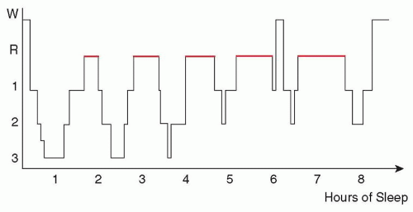
The problem
Breakdown of NREM Sleep Stages
Light Sleep (N1-N2):
Preliminary stages of sleep.
Deep Sleep (N3-N4):
Crucial for various bodily processes.
Production of delta waves identifiable in N3
Hypnogram
Source: https://neupsykey.com/sleep-disorders-13/
AI in predicting sleep stages:
Early detection: Potential to identify sleep disorders
Treatment integration: Help doctors’ recommendations based on individual patterns observed
Research support: Broadening the understanding of the role of sleep in general health (automating hypnogram annotation)

Slide 5
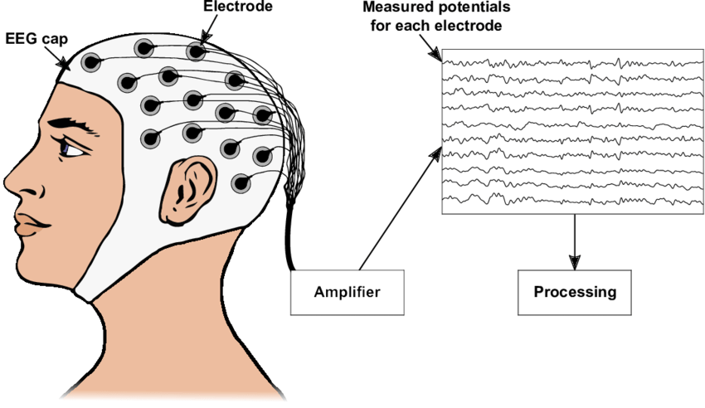
EEG Signal Basics
Physiological significance: reflects neural processes and cognitive functions through recording brain activity patterns and associating certain states
Source: “Towards a home-use BCI: fast asynchronous control and robust non-control state detection” (ResearchGate)
What it measures: records brain's electrical potentials.
How it is measured: electroencephalography electrodes placed on scalp; signals amplified and recorded.
Signal acquisition: standard 10-20 EEG setup consists of 19 channels
Our channels: Fpz-Cz (frontal to central), Pz-Oz (parietal to occipital)
General characteristics of signal: non-stationary (varies over time), dynamic patterns reflect brain function

Slide 6
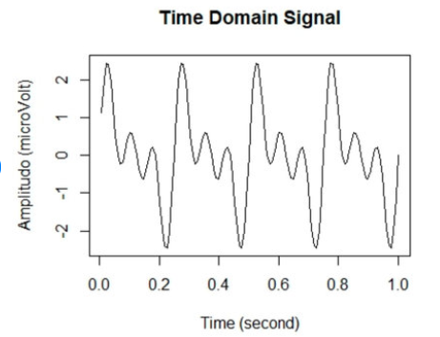
EEG Basics
Source: “Classification of Brainwaves for Sleep Stages by High-Dimensional FFT Features from EEG Signals” (ResearchGate)
Time domain features
Root-Mean-Square
Zero-Crossing-Rate
Mean, Standard Deviation, Variance, Skewness, Kurtosis
Reason for usage:
Characterize the overall intensity and variability of neural activity and temporal correlations
Higher RMS values may indicate higher signal intensity or increased neuronal activity), “Zero-crossing patterns reveal subtle epileptiform discharges in the scalp EEG” (https://www.nature.com/articles/s41598-021-83337-3)
Useful for AI models: even though patterns are not always obvious to humans, algorithms could find useful relationships between time-domain features and certain classes

Slide 7
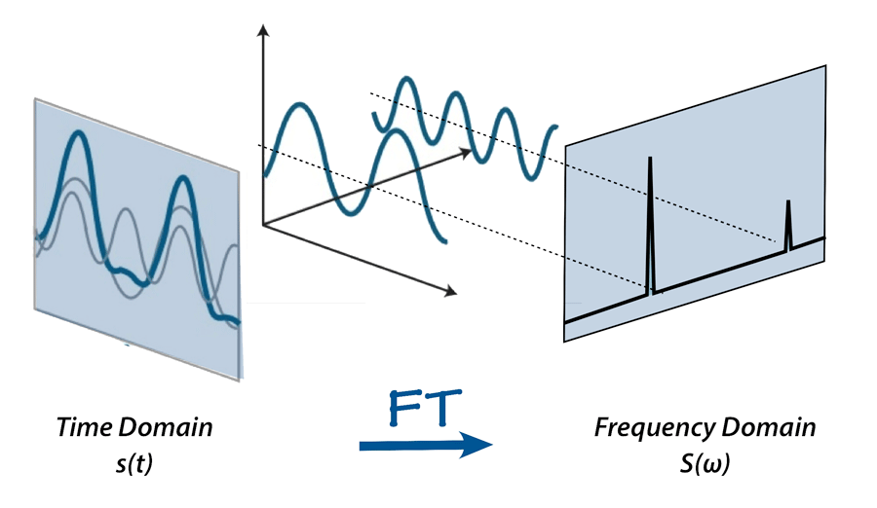
EEG Basics
Frequency domain features
Low delta (0.5-1 Hz), delta (1-4 Hz) , theta (4-8 Hz), alpha (8-12 Hz), sigma (12-15 Hz), and beta (15-30 Hz) bands relative power
Spectral Entropy, Katz Fractal Dimension
Spectral Edge Frequency
Inter-channel Itakura Distance
Source: Fundamental Terms of Signal Processing (Medium.com)
Reason for usage:
Different brain processes and cognitive states are associated with distinct frequency patterns in EEG signals (characteristic frequency patterns associated with different sleep stages)
Entropy measures capture the complexity and unpredictability of EEG signals
The Itakura-Saito distance is a non-symmetric measure of the difference between two probability distributions, can be adapted for frequency spectra

Slide 8
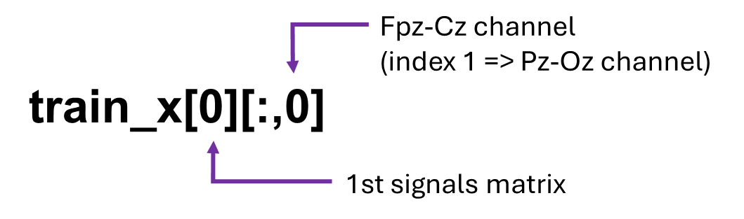
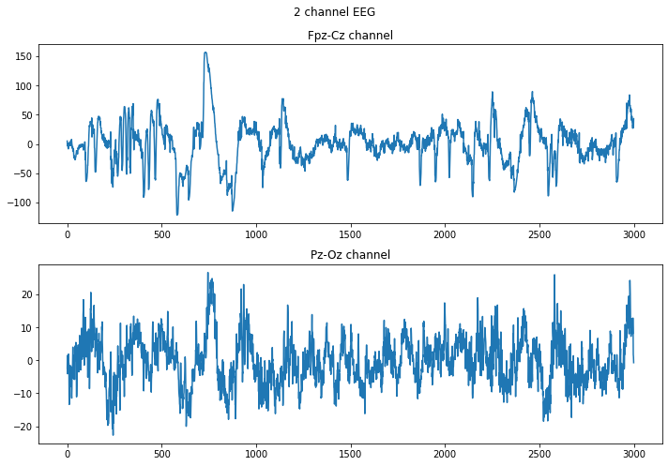
Project workflow
Importing and querying provided data
Our data is extracted from the Physionets Sleep EDF database.
The code looks through the data folders and reads each .csv file provided, each having the EEG recording for the Fpz-Cz and Pz-Oz channels
Classes in the y arrays as well as data arrays are read in the order found in folders (ex: train_x[5] has its corresponding class train_y[5])

Slide 9
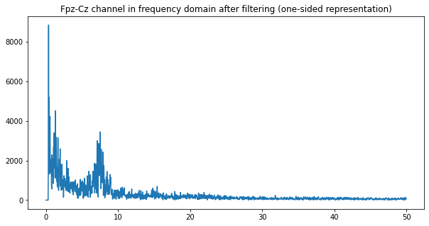
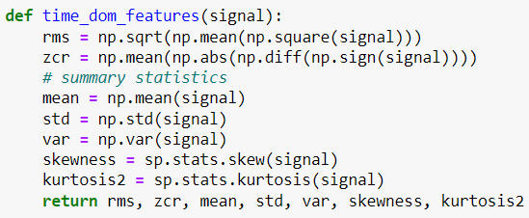
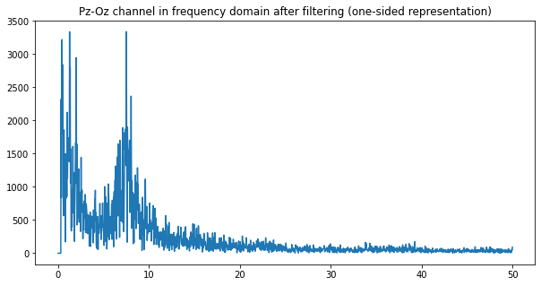
Project workflow
Functions for feature extraction
Frequency Domain Features:
FFT_prepare Extract_bands
Relative_power Itakura_dist_channels
Extract_entropies Spectral_edge_frequency
train_x[1356] signal matrix used for plots above

Slide 10
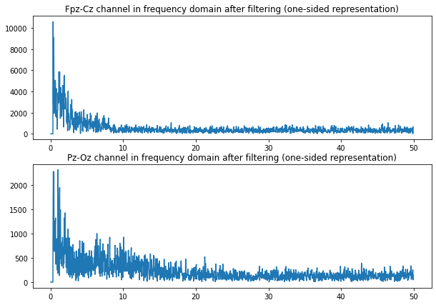
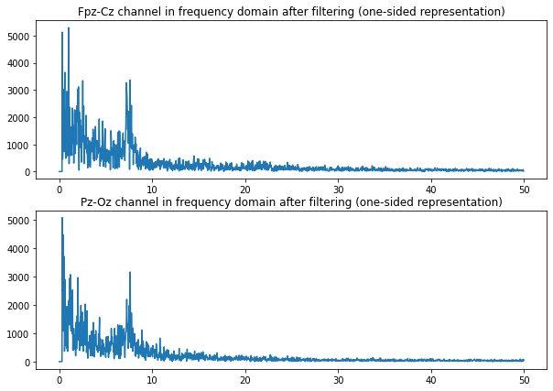
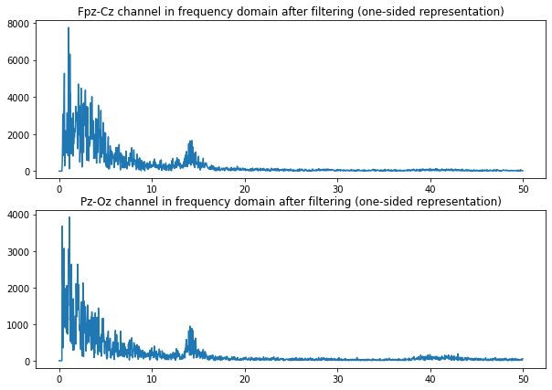
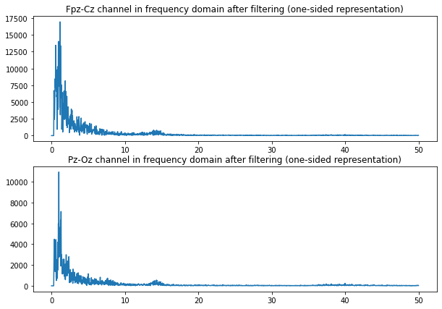

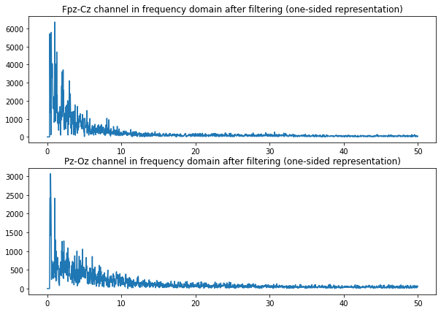
Awake
N1
N2
N3
N4
REM

Slide 11
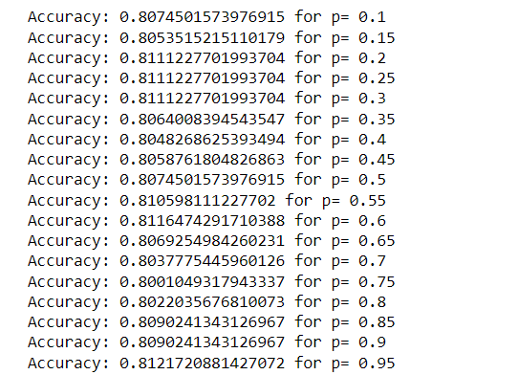
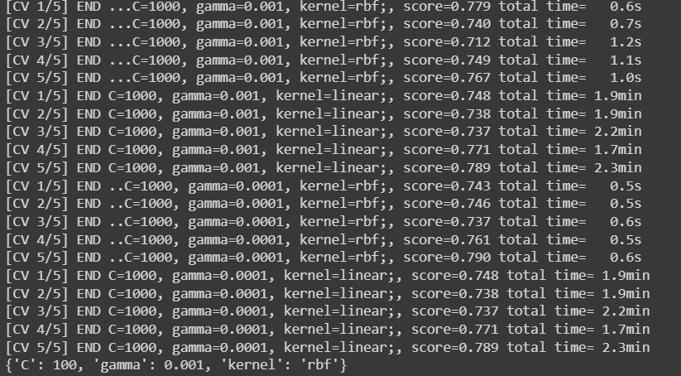
Spectral Edge Frequency Percentage choice
Excerpt from the hyperparameter grid search

Slide 12
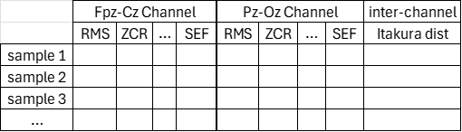
Project workflow
Dataset building
Features can thus be extracted from each signal matrix, so a set of time-domain features and frequency-domain features result from both the Fpz-Cz channel and Pz-Oz channel, along with the only one inter-channel feature
All this data should be stored in a comprehensible way to be “fed” to the ML algorithms
Training dataset length: 5963
Testing dataset length: 1906
Final number of features: 33

Slide 13
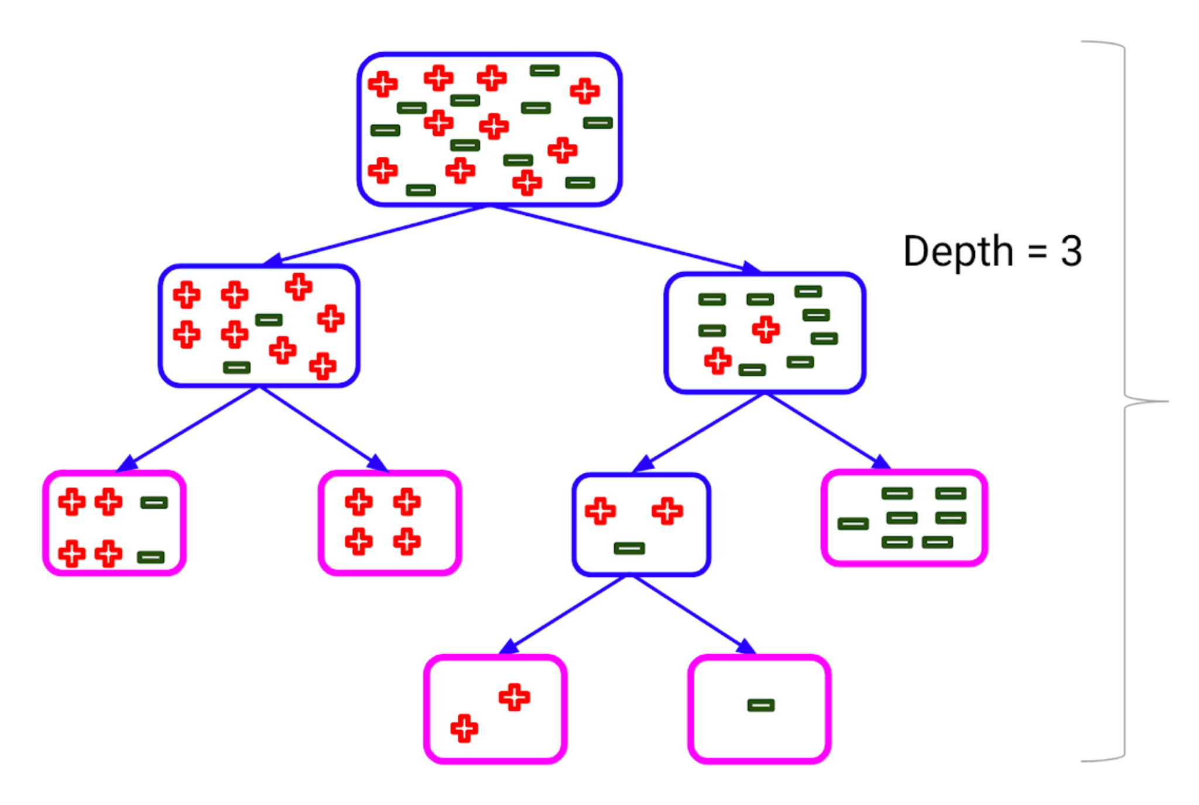
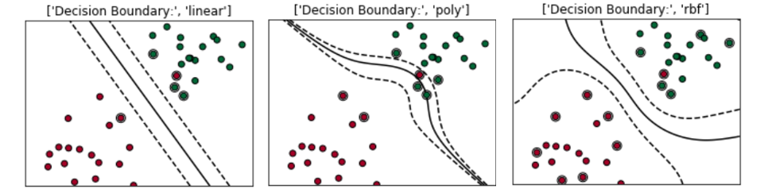
Machine Learning Algorithms
Source: https://www.analyticsvidhya.com/blog/2020/03/beginners-guide-random-forest-hyperparameter-tuning/
Random Forests (RF):
Combines the output of multiple decision trees to reach a single result for high-dimensional data.
Requires feature engineering for optimal performance.
Support Vector Machines (SVMs):
Effective for binary classification in feature-rich spaces utilizing a kernel trick to find optimal hyperplanes.
Also requires feature extraction.
Potential use of Neural Networks
process raw time series data directly, extract spatial features directly from EEG signals without prior feature extraction.
Source: “Support Vector Machine — Simply Explained” (Medium.com)

Slide 14
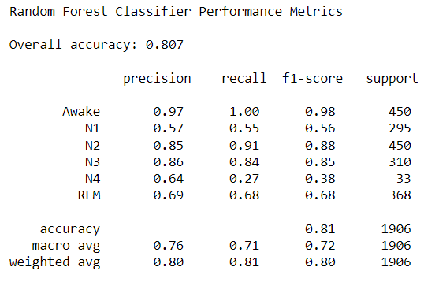
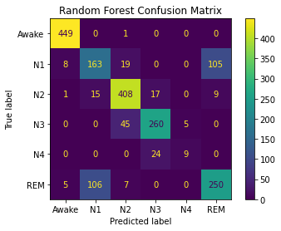
Implementation of Random Forest classifier
On different runs, accuracy might be slightly different (0.80 - 0.82) for the Random Forest Classifier because of the "randomness" that creating each decision tree involves
We haven’t performed hyperparameter tuning, but we could have altered the depth of each tree in the model, number of decision trees (estimators) or maximum number of features that the random forest model is allowed to try at each split.

Slide 15
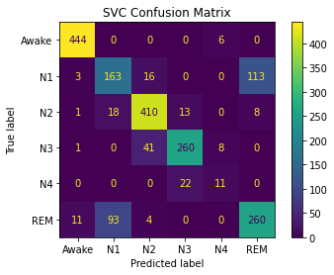
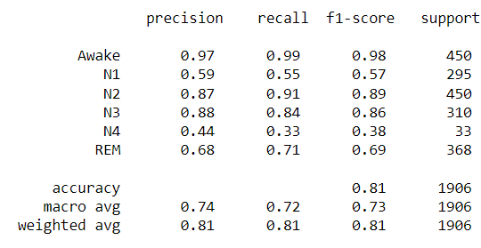
Implementation of Support Vector classifier
Implementation Details:
RBF kernel with hyperparameters:
C = 100
Gamma = 0.001
We utilized GridSearchCV for automatic hyperparameter optimization, the algorithm explored a range of hyperparameter values to find the best combination.
SVC accuracy value will remain constant at 0.812.

Slide 16
Results, findings and conclusions
Evaluation of used algorithms
It can be concluded that the models are able to distinguish between "Awake" and "People in any sleep state" but have troubles with distinguishing between different sleep stages.
Good predictions for the “Awake”, “N2” and “N3” classes
Not so good predictions for “N1”, “N4” and “REM” classes
One conclusion can be that both classifiers perform similarly on this classification problem.
Hyperparameter tuning could (should) be also done for the Random Forest implementation.
Presented accuracy is definitely biased due to dataset imbalance and model performance on specific classes, a more realistic evaluation of the models would require cross-validation techniques

Slide 17
Results, findings and conclusions
Observations for results
The reason why the models are not good with distinguishing between the sleep stages can be because the support data that is used to train and test the models has disproportionate representation for different stages (N4 class a really small support).
Importances were computed and it was noticed that each model focuses more on different features to "decide" on how they predict the sleep stage, but some important repetitions can be observed: feature index 3 (Fpz-Cz channel standard deviation), feature index 0 (Fpz-Cz channel Root Mean Square), feature index 28 (Pz-Oz channel Beta band power), feature indices 11 and 12 (Fpz-Cz channel Sigma and Beta band power), feature 17 (Pz-Oz channel Zero-Crossing-Rate), feature index 26 (Pz-Oz channel Alpha band power), feature index 29 (Pz-Oz channel spectral entropy)

Slide 18
Results, findings and conclusions
Potential for improvement
Extracting More Relevant and Useful Features:
Use supervised feature selection to filter out irrelevant features.
Feed neural network with signal chunks for nuanced patterns.
Advanced feature extraction captures detailed data characteristics.
Address Data Imbalance:
Some classes (like N4) had limited training/testing samples.
Implement techniques like gathering more data, oversampling or class weights adjusting.
Initial Awake State Classification:
Separate awake state classification before sleep stage prediction.
Minimize bias and improve model accuracy.
Focus more on different frequency band operations
What if we reconstruct time-domain signals for each frequency band and compute
time-domain features for each separate signal?

